Slide 1

Sandro Pereira
Integration MVP
BizTalk Server Fast & Loud

Slide 2


Slide 3
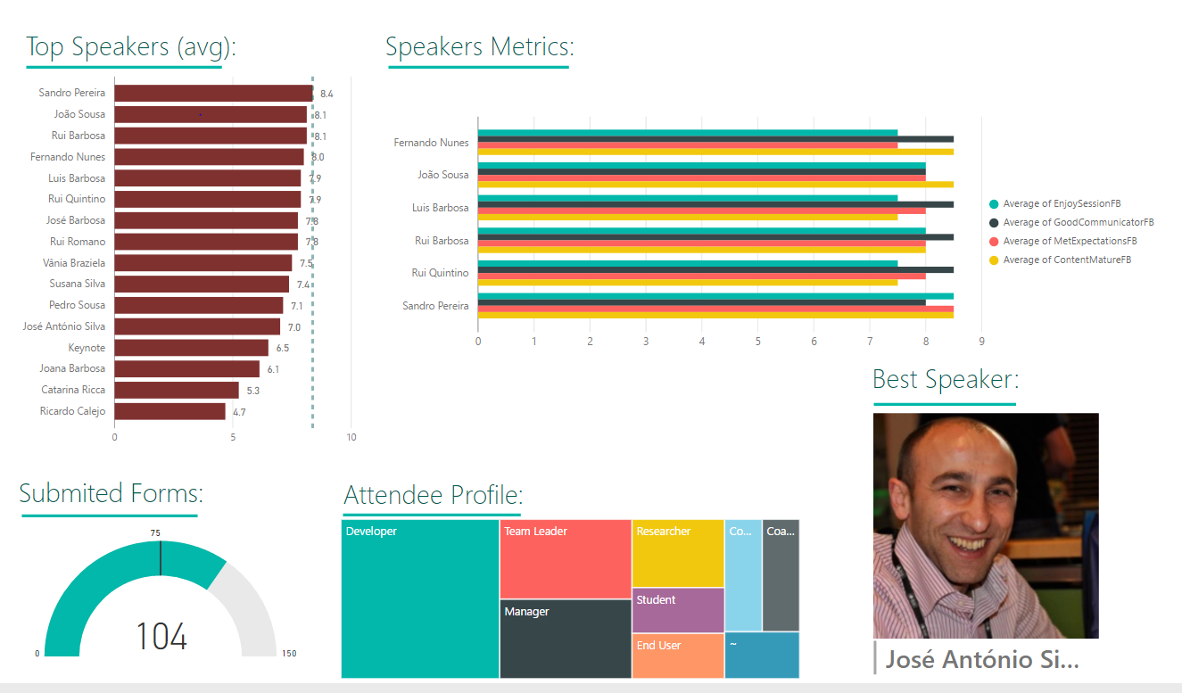
integrating paper…
OCR, Logic Apps & Power BI
KPI’s
Event Attendees
Logic Apps
Azure
Functions
Power BI

Slide 4

I

Slide 5

Really?! …
Can we change this story?

Slide 6

How many of you are still running BizTalk Server with a single host instances?

Slide 7
In a single box… what should be the maximum number of host instances?

Slide 8

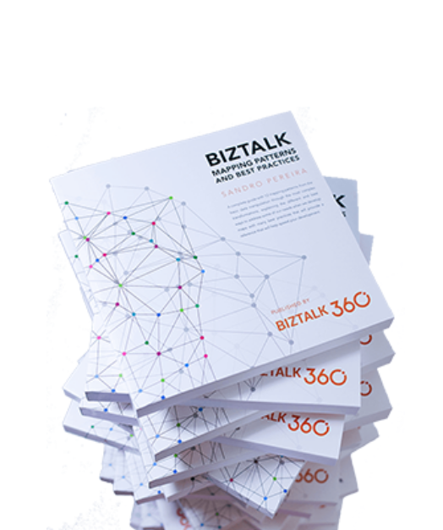

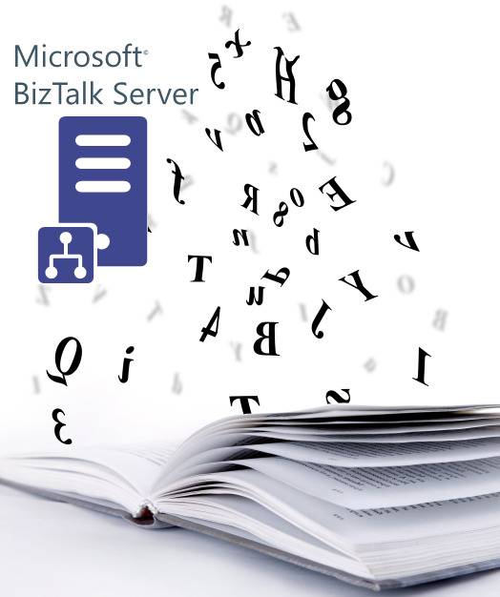




Who am I?
Codeless Wizard
Microsoft Azure & Visio MVP
sandro.pereira@devscope.net
linkedin.com/in/sandropereira
@sandro_asp
https://blog.sandro-pereira.com/
Public speaker
Book author: “BizTalk Mapping Patterns and Best Practices”
Sandro Pereira
Notes:
Interested in all things integration – which of course includes MS Flow

Slide 9

https://github.com/MicrosoftDocs/biztalk-docs
BizTalk Server Documentation…
is on DOCS!
You can start contribute TODAY!

Slide 10


BizTalk Server stickers
Tweet #Integrate2017
#msbts @sandro_asp
“Goodbye T-REX, welcome BizMan the BTS Super hero”

Slide 11


…and Loud
Fast…

Slide 12
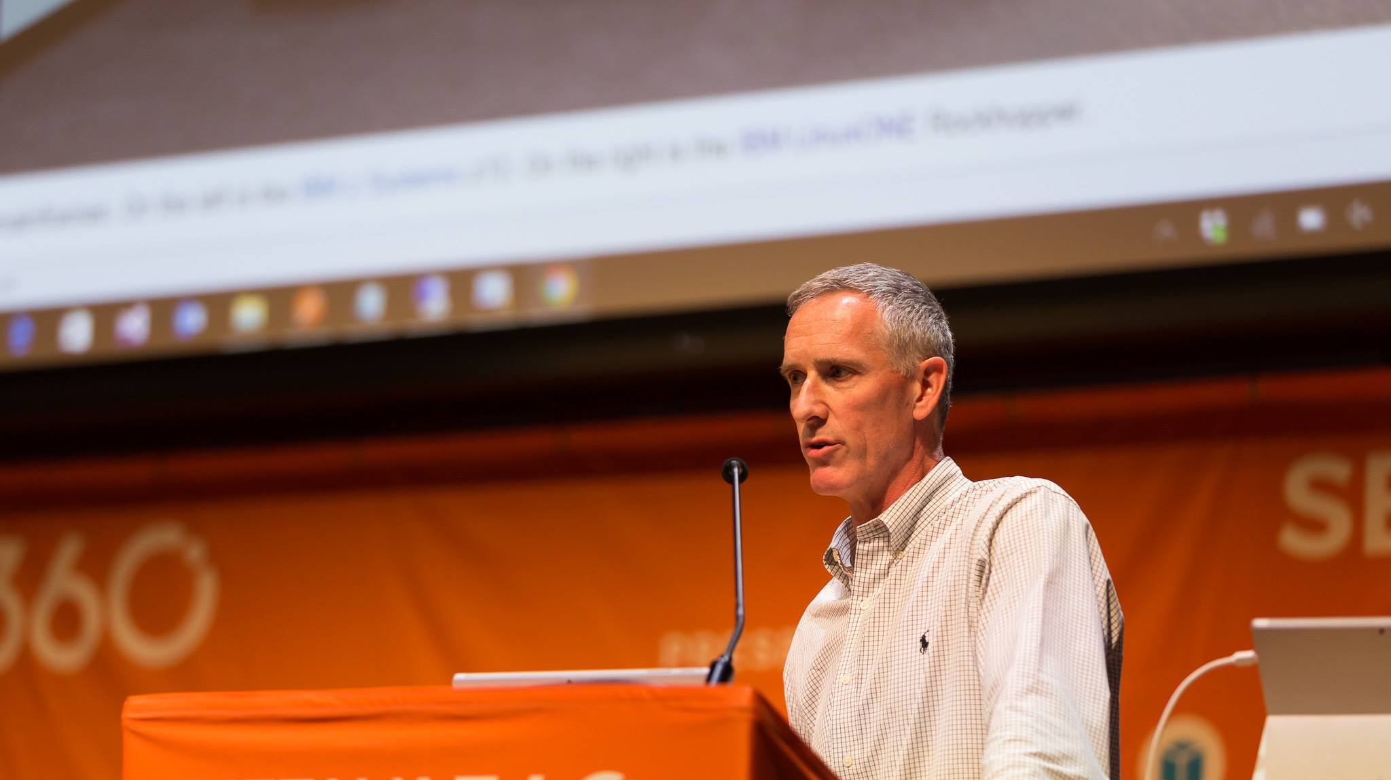
BizTalk Server is almost
17 years old and…

Slide 13
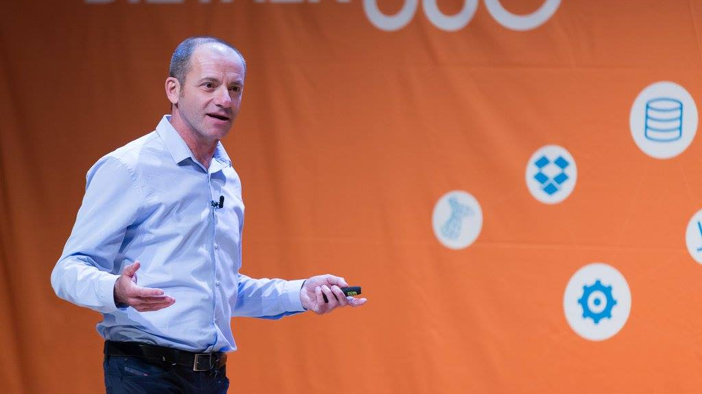
I still find clients that don’t have BizTalk Jobs running!

Slide 14





BizTalk Server can be…

Slide 15

… is just how much
you want to
spent!

Slide 16

BizTalk Server default installation

Slide 17

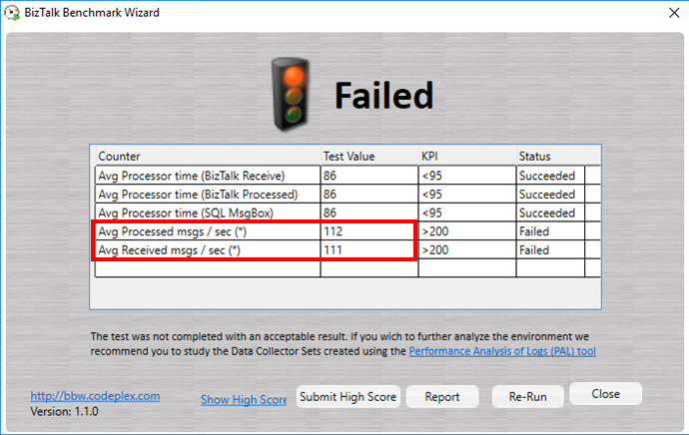
Ouch!
59 msg/min
0 msg/sec
1025 ms response time per msg

Slide 18

~86,5 %
archive ………………
response time decrease

Slide 19
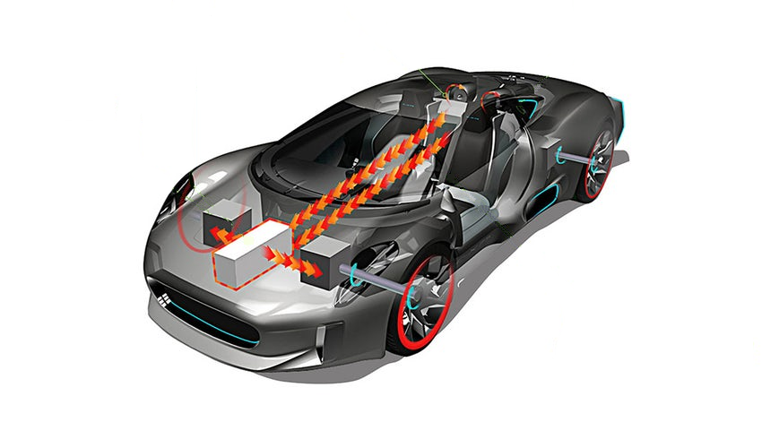
Memory
CPU
Battery
Fuel Injector
Car chassis
Exhaust pipe
BizTalk Server
Network
Virtualization layer
Hard drivers
Engine
Tiers
SQL Server

Slide 20
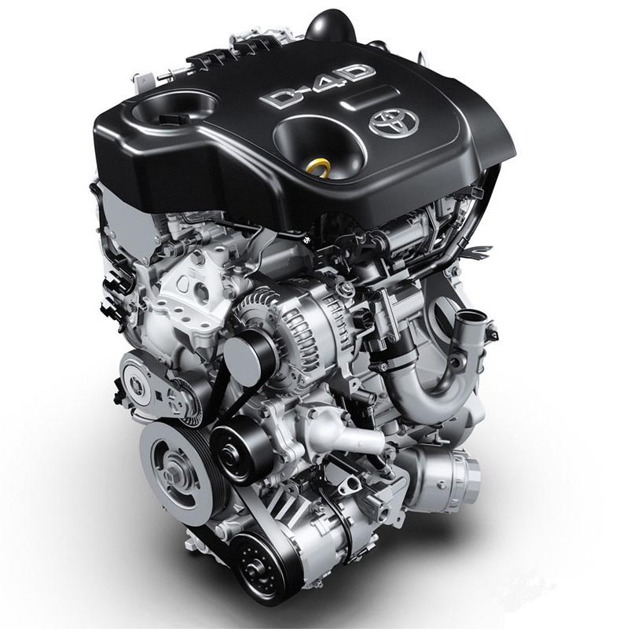
SQL Server
“Life would be easier
If we could mark
SQL Admins as spam”

Slide 21

Backup BizTalk Server (BizTalkMgmtDb)
DTA Purge and Archive (BizTalkDTADb)
BizTalk Server SQL Server Agent jobs configured and running…
Notes:
SQL Agent - All cleanup is done by SQL Jobs
If this isn't running, neither will BizTalk
Backup BizTalk Server (BizTalkMgmtDb)
DTA Purge and Archive (BizTalkDTADb)
MessageBox_Message_Cleanup_BizTalkMsgBoxDb disable

Slide 22

Treat BizTalk Server databases like a Black box…
Notes:
Don’t create custom maintainance plans for backup, re-índex, shrinking and all these common task that we normally do with regular databases

Slide 23

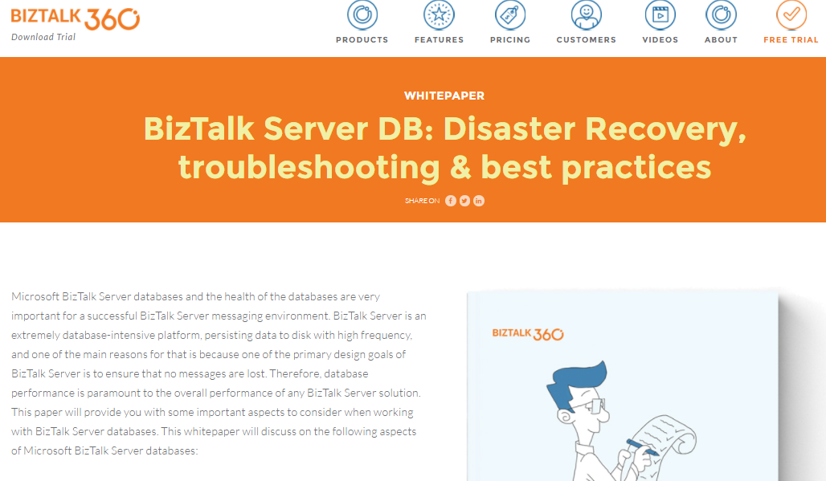
Size matters...
…Large databases impact performance
Notes:
BizTalk Database Auto-growth Settings
Default (1MB, 10% log files) is not sufficient
SQL Server database auto-growth is a blocking operation which hinders BizTalk Server database performance.
5 GB - BizTalkMsgBoxDb 8 files 2GB
MarkLog tables that are never clean

Slide 24


Consider running them on Dedicated SQL Server resources…
Notes:
Disable the Auto Update Statistics and Auto Create Statistics Options
Set the Max Degree of Parallelism property to “1”

Slide 25

Consider splitting
TempDB into
multiple data files…
Notes:
The SQL Server uses TempDB to store intermediate results as part of executing a query
If the number of logical processors is less than or equal to 8, use the same number of data files as logical processors.
If the number of logical processors is greater than 8, use 8 data files
if you get contention problems, you should increase the number of data files by multiples of 4.
Creating files across multiple drives will help increase the IO bandwidth but will have no additional impact on allocation bottleneck.
Preallocate space for all tempdb files by setting the file size to a value large enough to accommodate the typical workload in the environment. This prevents tempdb from expanding too frequently, which can affect performance.
Make each data file the same size

Slide 26


Hard drivers
Network
Virtualization layer
“Speed defines everything”

Slide 27

At the very minimum you should have 1 logical disk for data files, 1 for transaction log files, and 1 for tempdb data files…
…
Notes:
If your using it, make it fast
Check for I\O issues
Never go below 15% free disk space
Periodically defragment all disks (local and SAN/NAS) on a regular basis by scheduling off-hours disk defragmentation
Monitor the disk read and write times. The faster the access time the better performance SQL Server will provide. Any disk read or write time approaching 15 ms is cause for concern.
Isolate the BizTalk database files on dedicated LUNs. This will prevent other applications from affecting the BizTalk databases
RAID 5 most common - RAID 10 critical missions

Slide 28

10Gb+
networks…
Remove unnecessary
network protocols…

Slide 29

Memory
CPU
“These days… licensing is more expensive than hardware!”

Slide 30

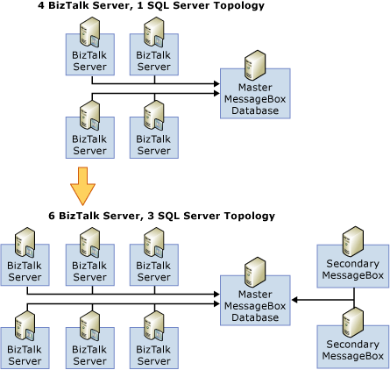
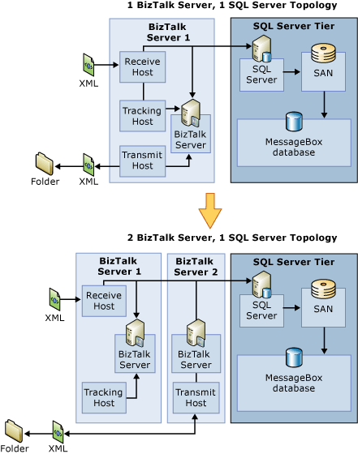
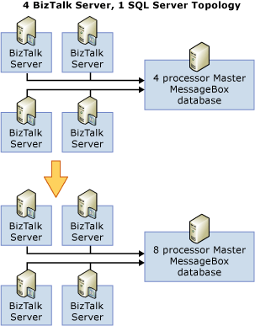
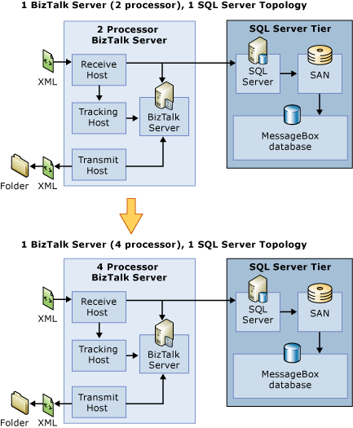

Scaling Out the BizTalk Server Tier is not a solution to all problems…
Notes:
Scaling Up the BizTalk Server Tier
Scaling Out the SQL Server Tier
Scaling Up the SQL Server Tier

Slide 31

Let's Rock'n Roll…

Slide 32

“Don't Judge what you don't understand…”
BizTalk Server

Slide 33

I'm screwed...
my wife is going to kill me…

Slide 34

How can I park more cars…

Slide 35

…disable unnecessary
services…
Downloaded Maps Manager
Windows Search
Print Spooler
Windows Defender
…

Slide 36


Slide 37

Response: 20 host instances…
…due to allocated resources!
Notes:
BizTalk databases should be treated like a black box… don’t touch… don’t change!
BizTalk databases are not regular databases, like all products they are particular specifications… and you should be aware of them to be able to do anything properly.

Slide 38
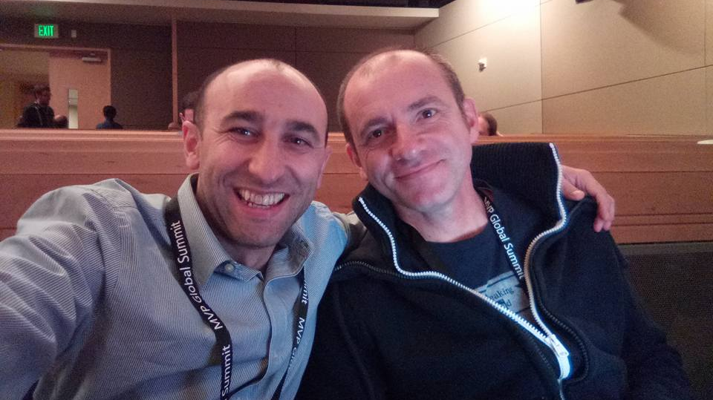
Thank you!

Slide 39

"Begin to be now what you will be hereafter."
William James

Slide 40


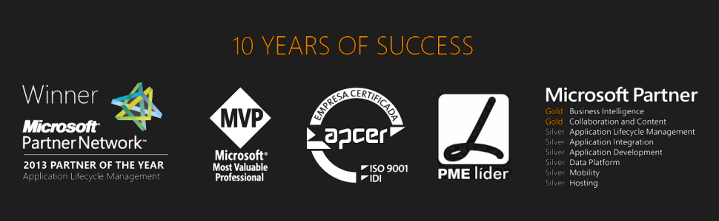



Thanks
sandro.pereira@devscope.net
linkedin.com/in/sandropereira
@sandro_asp
sandroaspbiztalkblog.wordpress.com
+351 223 751 350
www.devscope.net

